Slide 1
Advanced Programmig Group Project Python Pong Game
Prepared By: Martin Ehab, Mazen Khodier
Mohamed Hatem
Submitted to Prof . Rami Zewail

Slide 2
TABLE OF CONTENTS
03
01
02
04
Project Idea & Goals
Accomplishments & Demo
Design Decisions
Challenges & Future Work

Slide 3
01
Project Idea & Goals

Slide 4
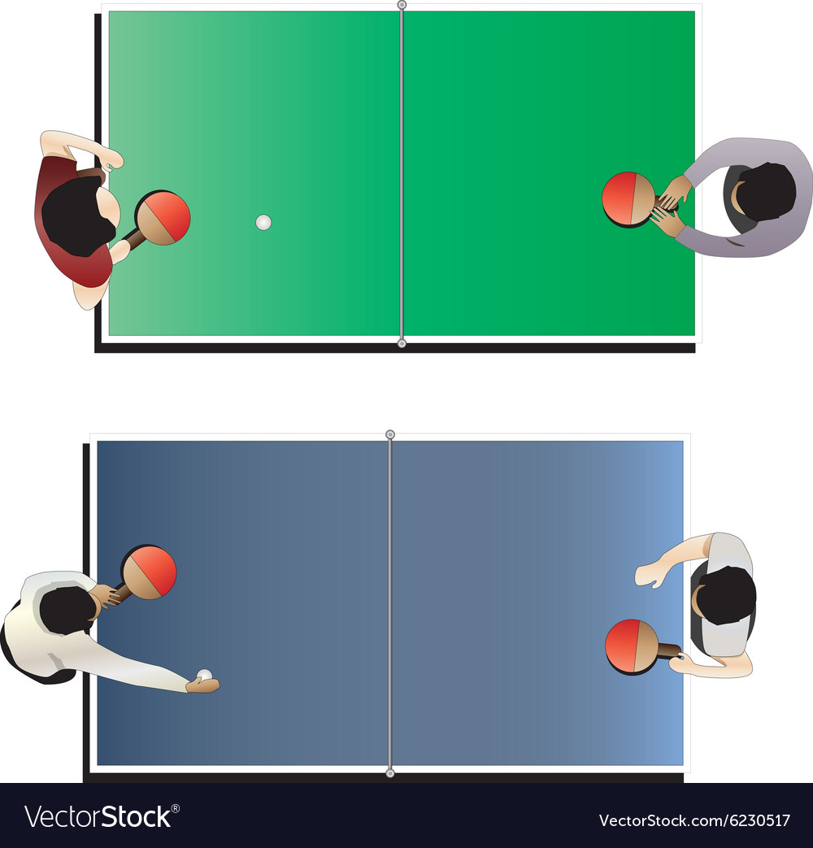
Ping Pong
Also known as table tennis
Involves two players
The objective is to get the ball over the opponent’s side
Can also be played alone by folding half of the table

Slide 5
Project Idea
Pong is a computer version of ping-pong, in which players control opposing "paddles" and try to knock a ball back and forth. If the ball gets past from the border, you lose a point.
Players can move their paddles up and down on the screen, and when the ball hits the paddle it bounces off.
The ball should also bounce off the floor and ceiling and will need to detect when it has gotten past a paddle.
The ball bounces at a more extreme angle as it hits further away from the center of the paddle.

Slide 6

Goal Features in Mind
Single and Multiplayer modes with Scoreboard
Ability to either use mouse or keyboard in single player
AI Opponent (possibly using computer vision)
Customizable Settings (Difficulty, Random Physics, Background, etc.)
User Interface in form of menus for Navigation inside the program
A guide page on how to play

Slide 7
TABLE OF CONTENTS
03
01
02
04
Project Idea & Goals
Accomplishments & Demo
Design Decisions
Challenges & Future Work

Slide 8
02
Design Decisions

Slide 9
Decision Making Process
Object-Oriented
Pygame Library
Random Library
Complex Physics
Main Menu & Settings
Interaction between various objects: Ball, Paddles, etc. through Game class
& Menu Inheritance
Heavy use of pygame for drawing objects and such
Have the ball go into a random direction at the start
Calculate distance of ball from puddle center upon impact to vary speed of reflection
Separate files for program and that of menus

Slide 10
TABLE OF CONTENTS
03
01
02
04
Project Idea & Goals
Accomplishments & Demo
Design Decisions
Challenges & Future Work

Slide 11
03
Accomplishments & Demo

Slide 12
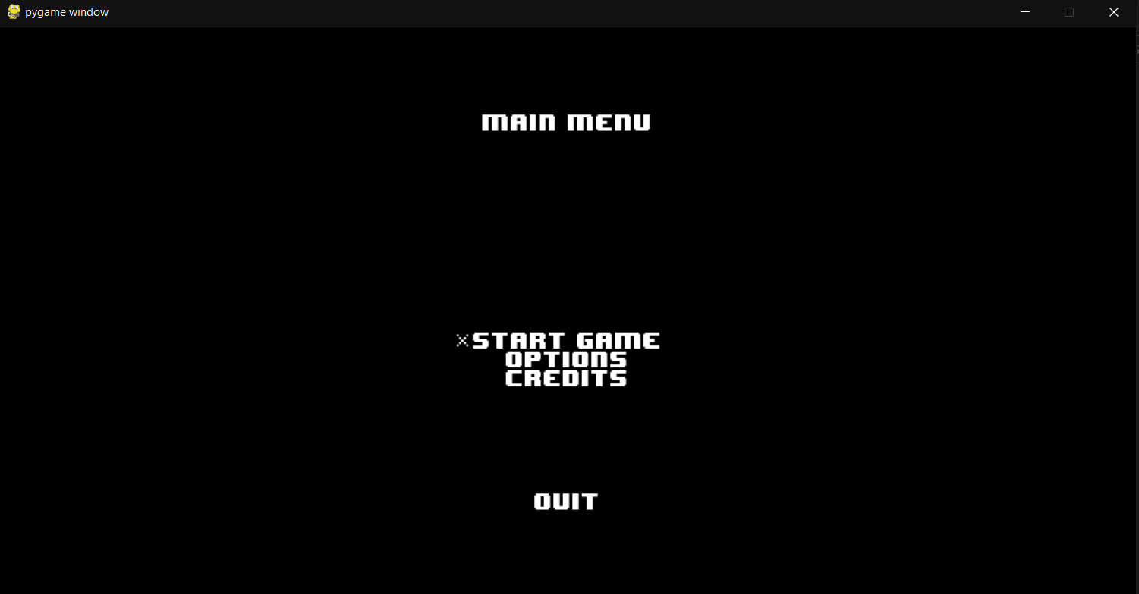

Slide 13
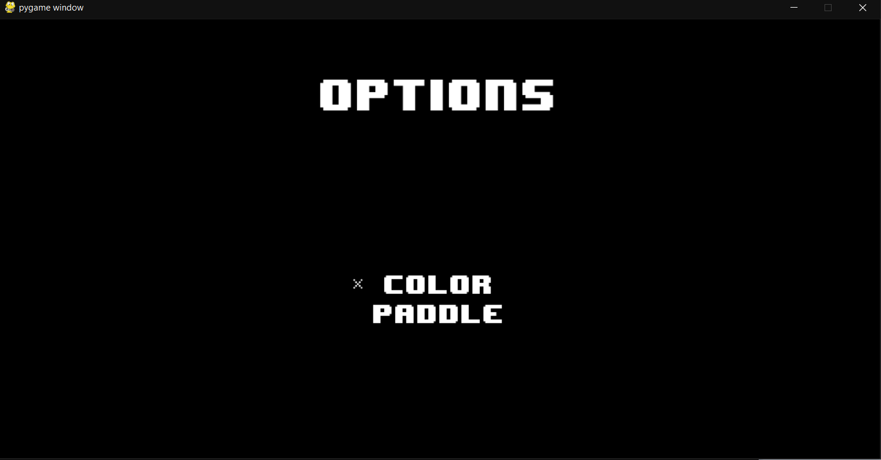

Slide 14
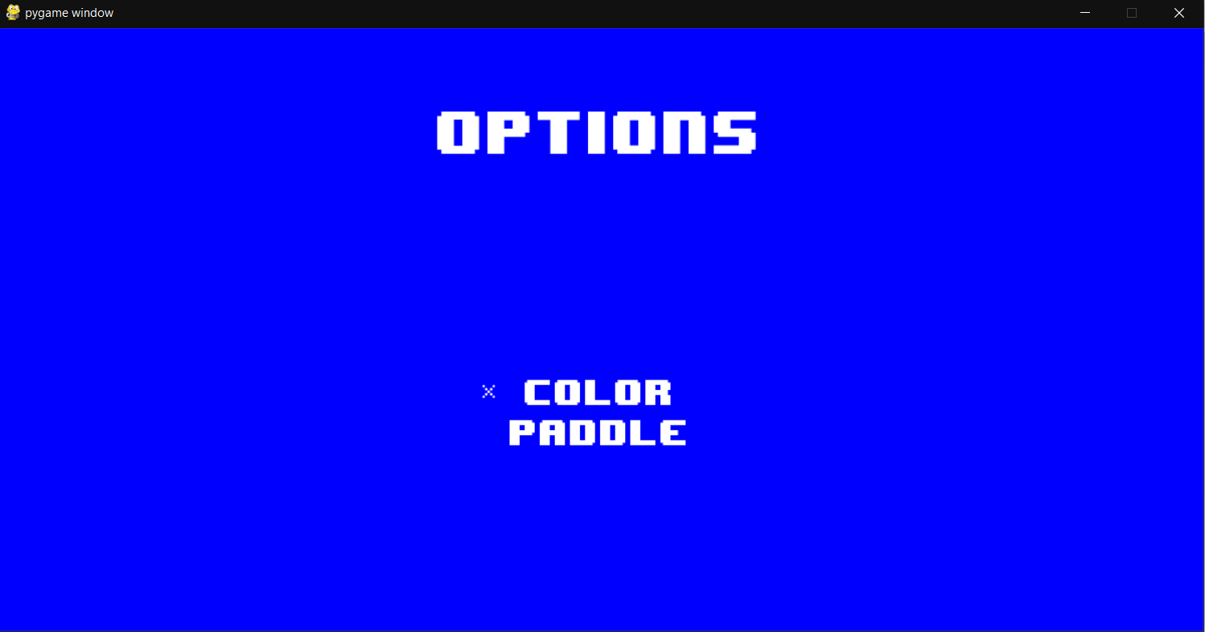

Slide 15
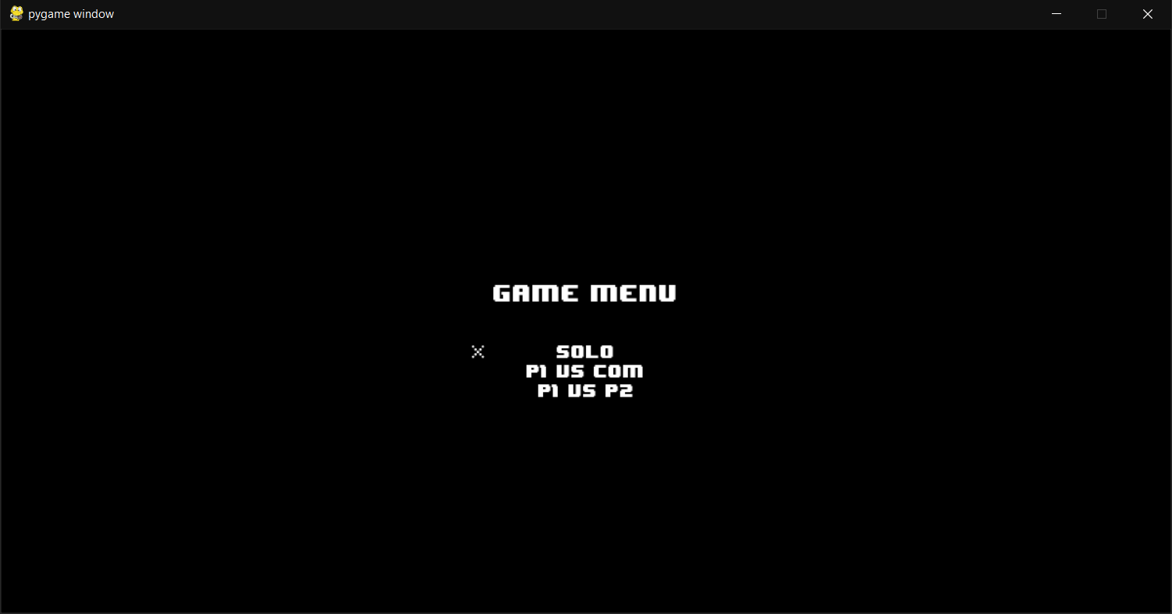

Slide 16
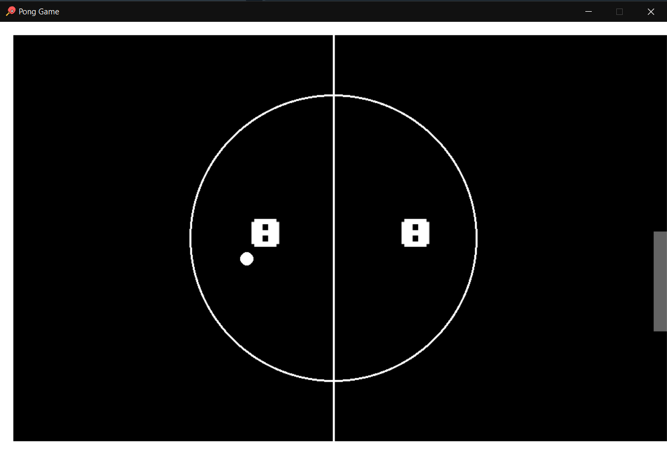

Slide 17
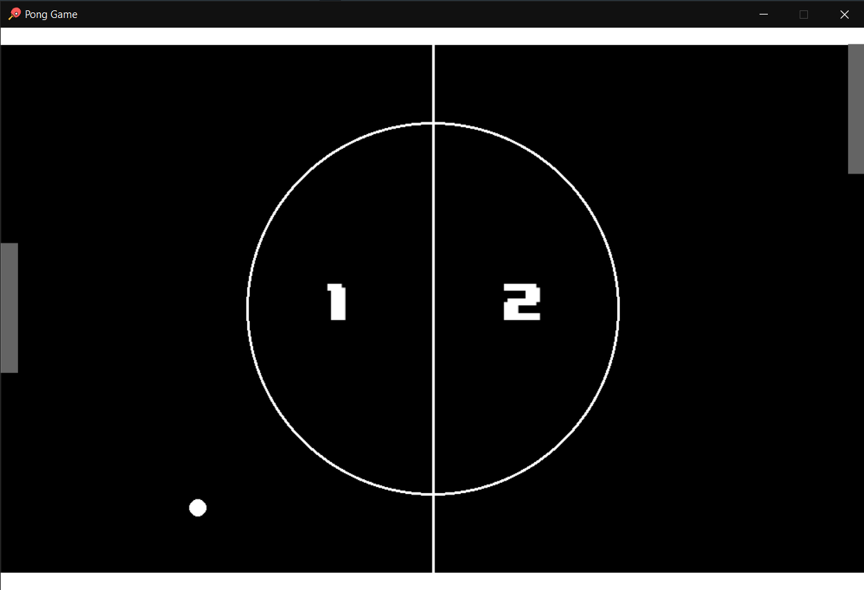

Slide 18
TABLE OF CONTENTS
03
01
02
04
Project Idea & Goals
Accomplishments & Demo
Design Decisions
Challenges & Future Work

Slide 19
04
Challenges & Future Work

Slide 20

Solution
Problem
More complex conditionals were used, axis-aligned bounding boxes (aabb) collision algorithm
BUG collision code for the ball with the walls

Slide 21
Solution
Problem
Further Modifications Needed
File's interaction was very complex (menu and game) files

Slide 22
Future Work
Deep Learning
Pause
Difficulties
Puddle Designs
Backgrounds
Max. Score
Add SFX
How to Play
Fullscreen

Slide 23
References
1- "Pong." - Wikipedia, the free encyclopedia 3 February 2008, -
2- Winter, David. “PONG-Story.” 29 February 2007, - <http://www.pong-story.com>
3- “About Game and Simulation Programming” DeVry University.
<http://www.devry.edu/programs/game_and_simulation_programming/about’s.
<http://en.wikipedia.org/wiki/Pong>

Slide 25
